Slide 1
.
Important Information regarding the use of aerosols in school.

Slide 2
What is asthma?
Asthma is a long-term condition that affects your airways - the tubes that carry air in and out of your lungs. You could say that someone with asthma has 'sensitive' airways that are inflamed and ready to react when they come into contact with something they don't like.
Asthma tends to run in families, especially when there's also a history of allergies.
Tragically, three people die every day because of asthma attacks and research shows that two thirds of asthma deaths are preventable. The reassuring fact is that most people with asthma who get the right treatment - and take it correctly - can manage their symptoms and get on with what they want to do in life

Slide 3
What is an asthma attack?
You're having an asthma attack if any of the following happens:
Your reliever isn't helping or lasting over four hours
Your symptoms are getting worse (cough, breathlessness, wheeze or tight chest)
You're too breathless or it's difficult to speak, eat or sleep
Your breathing is getting faster and it feels like you can't get your breath in properly
https://www.youtube.com/watch?v=5F9jpJpwOys

Slide 4
This is what it is like for an asthma sufferer
https://www.youtube.com/watch?v=5F9jpJpwOys
An asthma attack can be fatal
Spraying an aerosol spray e.g. deodorant can TRIGGER an asthma attack in many sufferers:

Slide 5
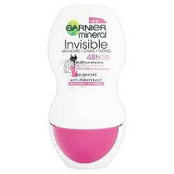
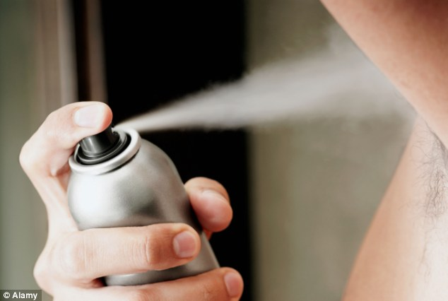
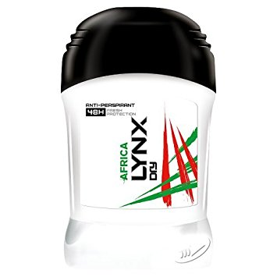
Aerosols should not be brought into school
Roll-on deodorant; stick or non-aerosol sprays are allowed for use after PE or other physical activity

Slide 6
.
Thank you for considering how your behaviour and actions can have an impact on other people around you.
Do not bring aerosols into school. It could cost someone their life.

